Slide 1
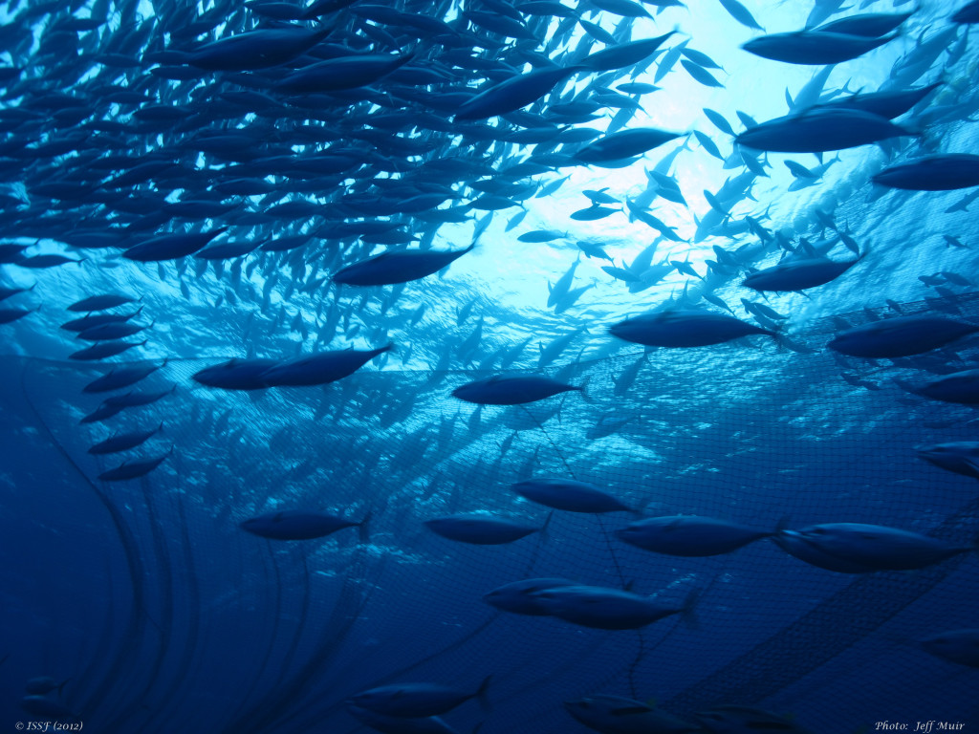
Regional Collapse
What factors predispose fish populations to collapse?
Emma Fuller – Princeton
Edgar J Gonzalez – UNAM
Ingrid Knapp- University of Hawaii
Annie Adelson – Stanford
Benjamin Carr – Boston University
Vanessa Michelou - University of Hawaii
Nina Lany – Dartmouth College

Slide 2
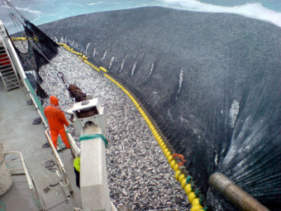
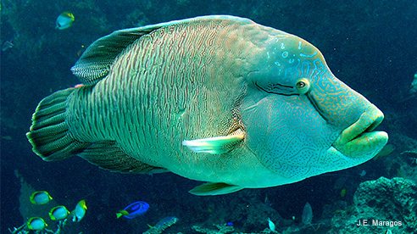
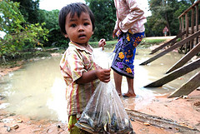
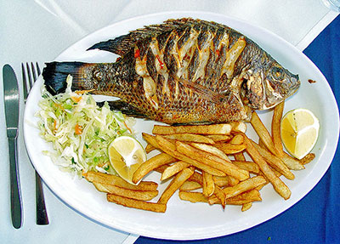
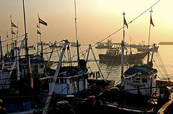
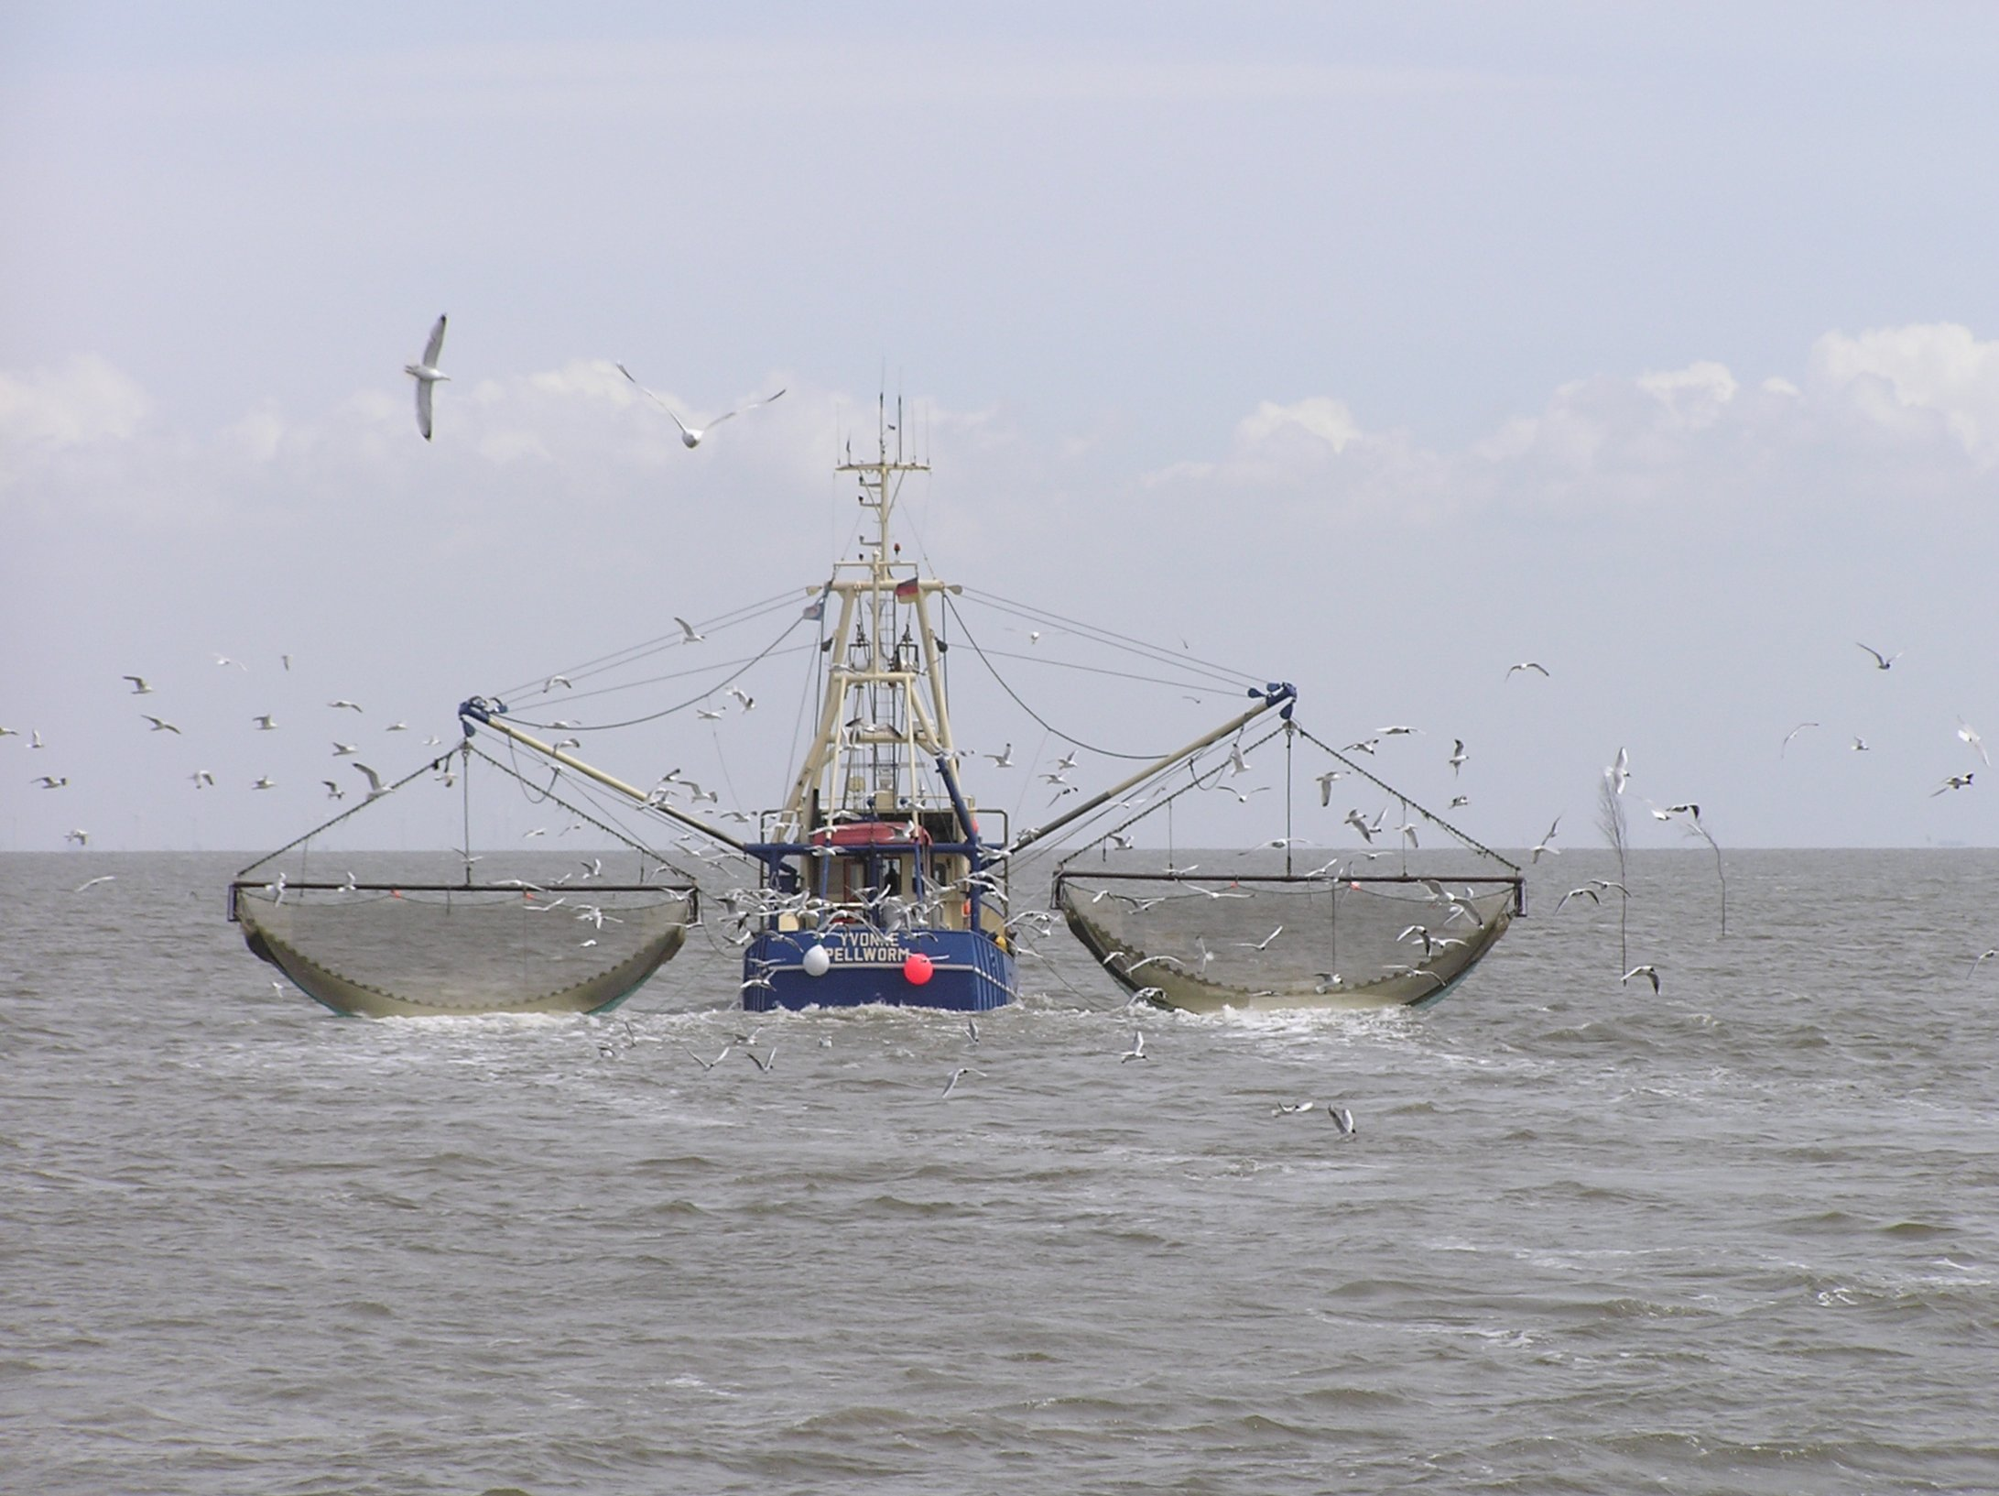
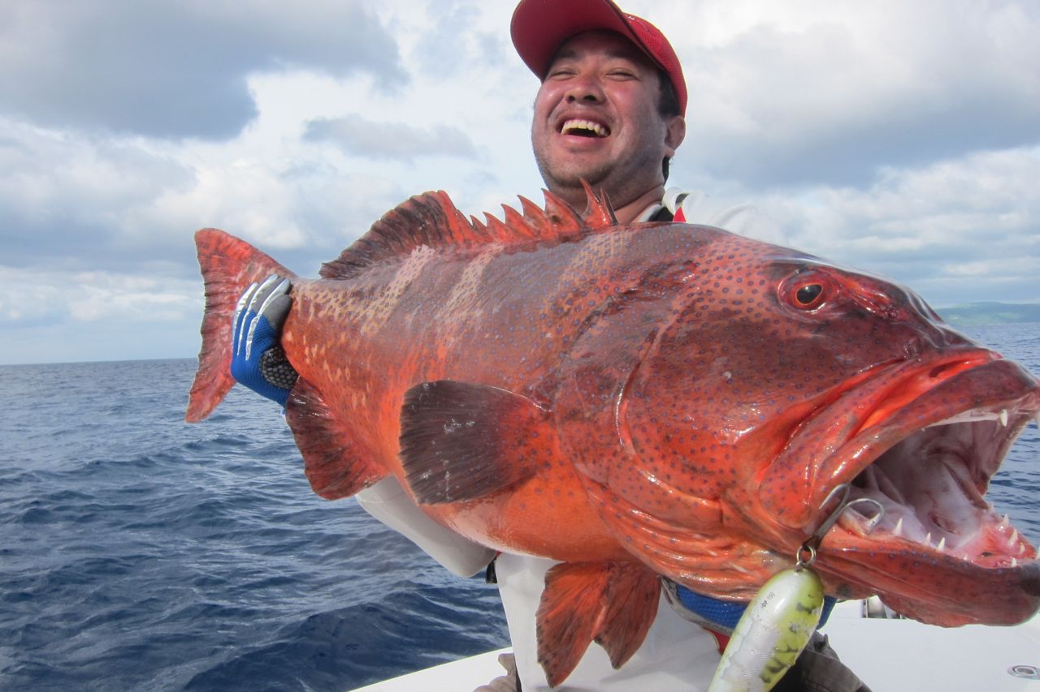
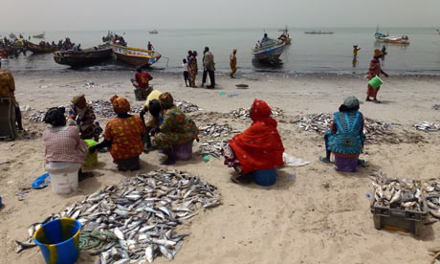
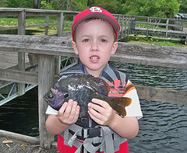
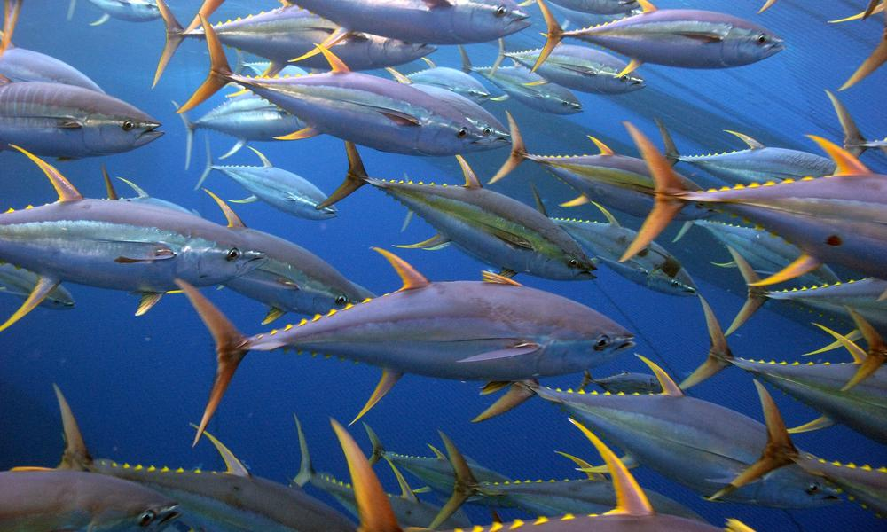


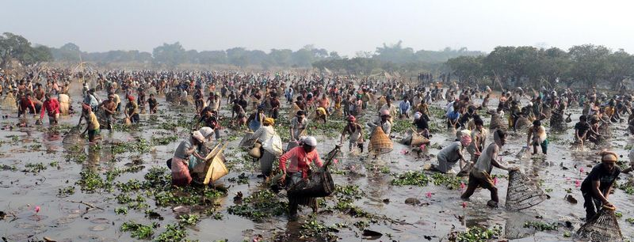
Fish are important for food and jobs

Slide 3
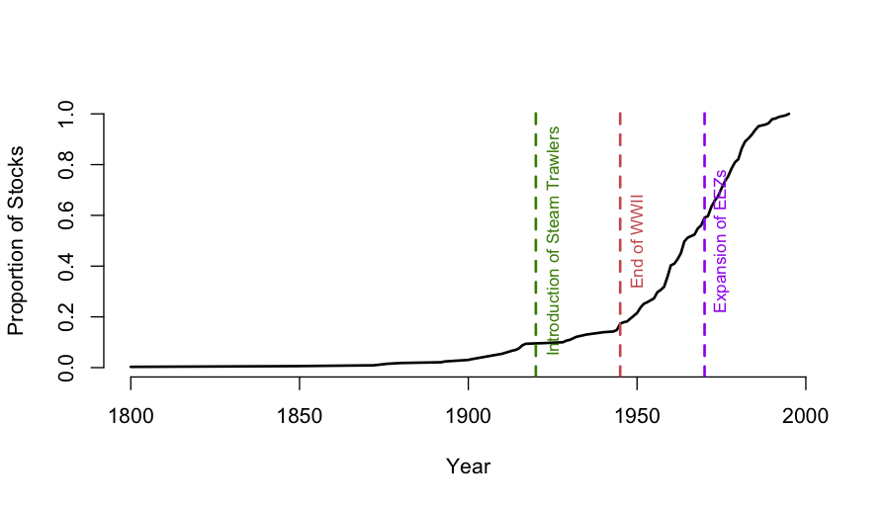
The History of Fishery Surveys

Slide 4
Notes:
Fish have had a long history of management in part because fisheries are a textbook example of “tragedy of the commons”. Everyone is incentivized individually to cause a collective collapse.
The way that fisheries have been managed is utilitarian, it’s to maximize the long term sustainable yield.

Slide 5
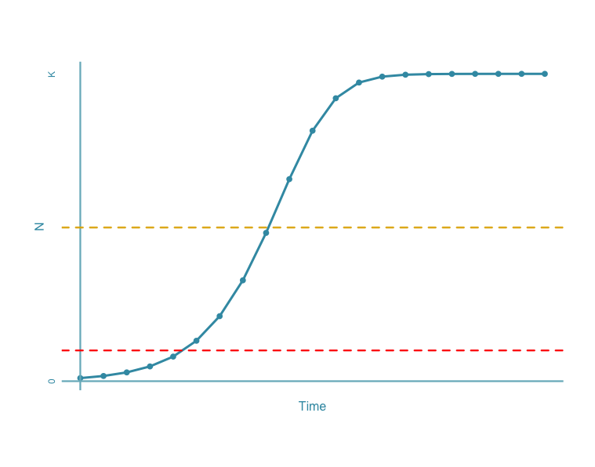
Fisheries Collapse
Maximum Sustainable Yield is defined as one-half of the carrying capacity
The definition of Collapse has been widely agreed on as: 20% of the Maximum Sustainable Yield
MSY
Collapse
Costello, C. et al. 2012. Status and Solutions for the World’s Unassessed Fisheries. Science 338:517–520.
Myers, R. A., J. A. Hutchings, and N. J. Barrowman. 1997. Why do fish stocks collapse? The example of cod in Atlantic Canada. Ecological applications 7:91–106.
Worm, B., et al. 2009. Rebuilding Global Fisheries. Science 325:578 –585.

Slide 6
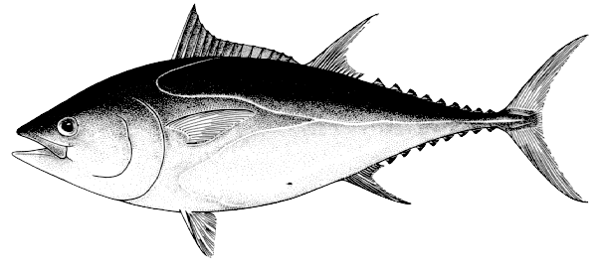
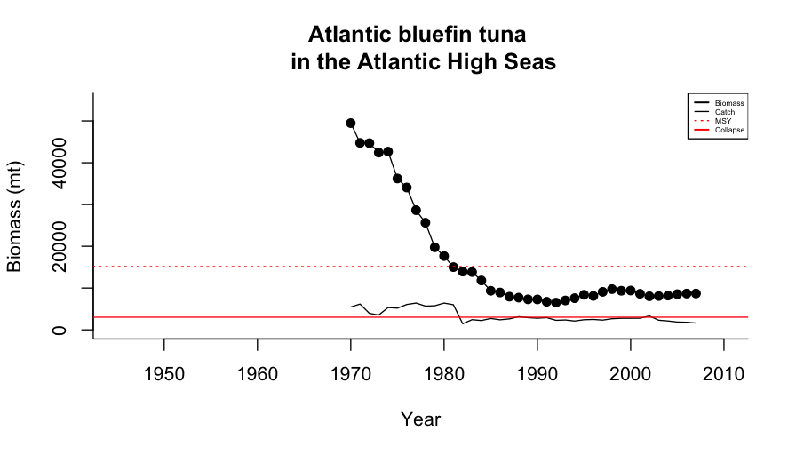
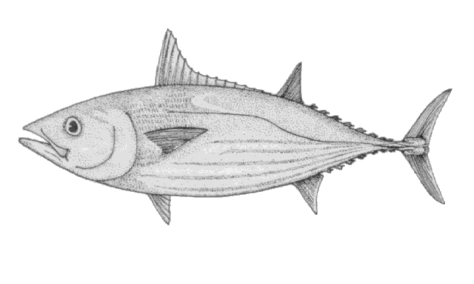
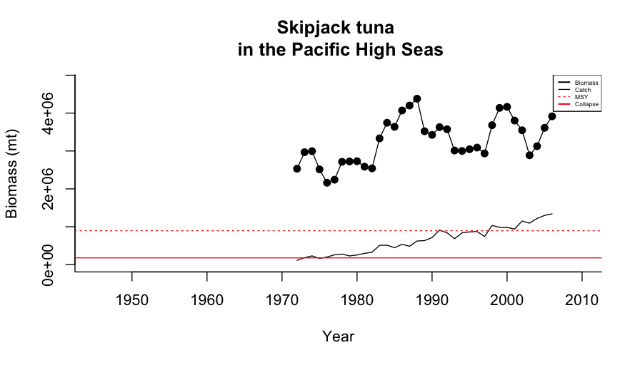
MSY
Collapse
MSY
Collapse

Slide 7
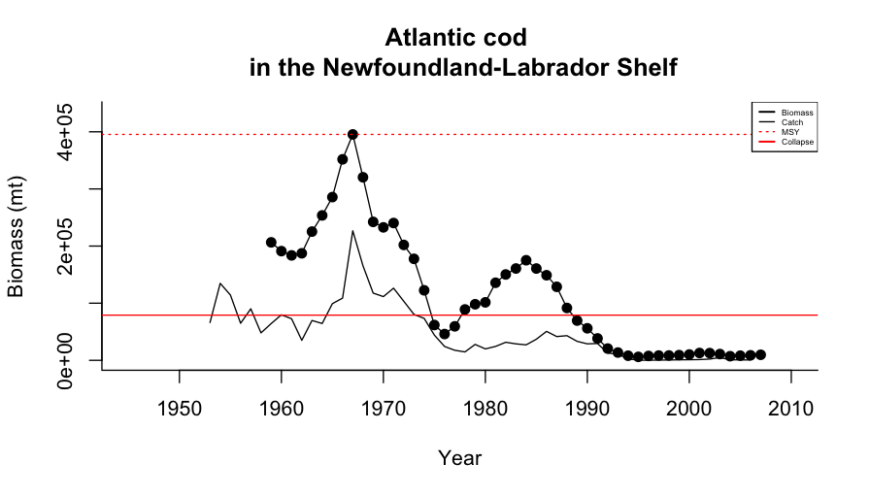
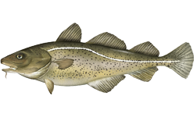

Iconic Atlantic cod fishery Collapse
40,000 fishery workers lost their jobs overnight
Notes:
2 July, 1992 fisheries minister John Crosbieunder police protection
Announced a two-year moratorium on cod fishing

Slide 8
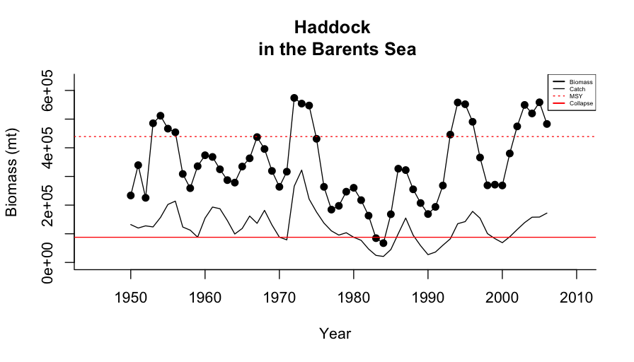
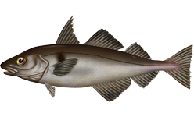
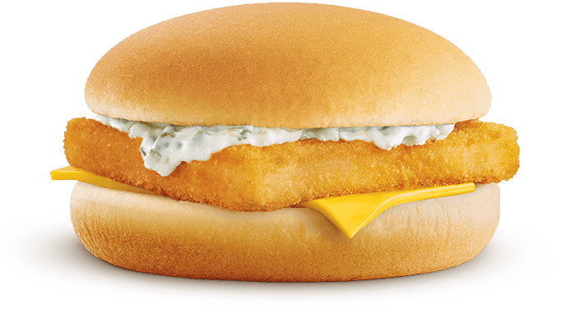
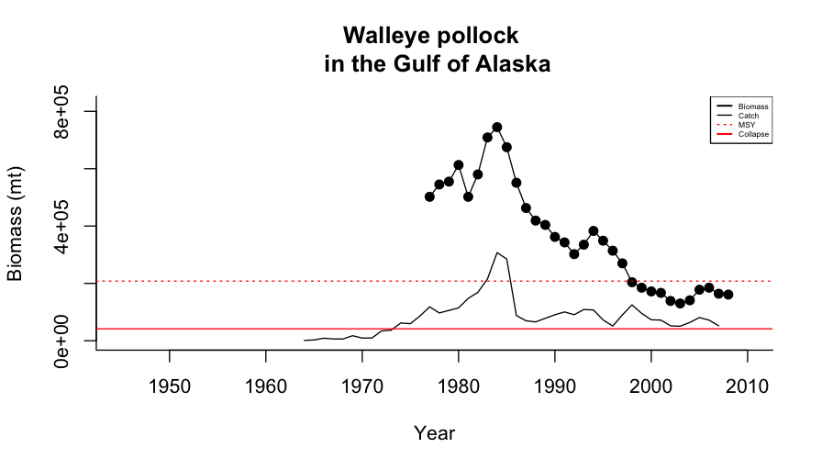
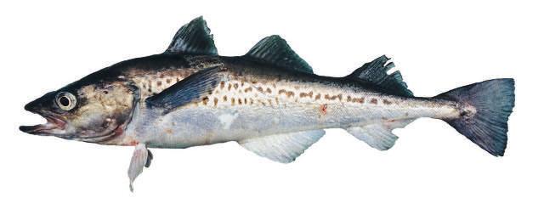

Slide 11
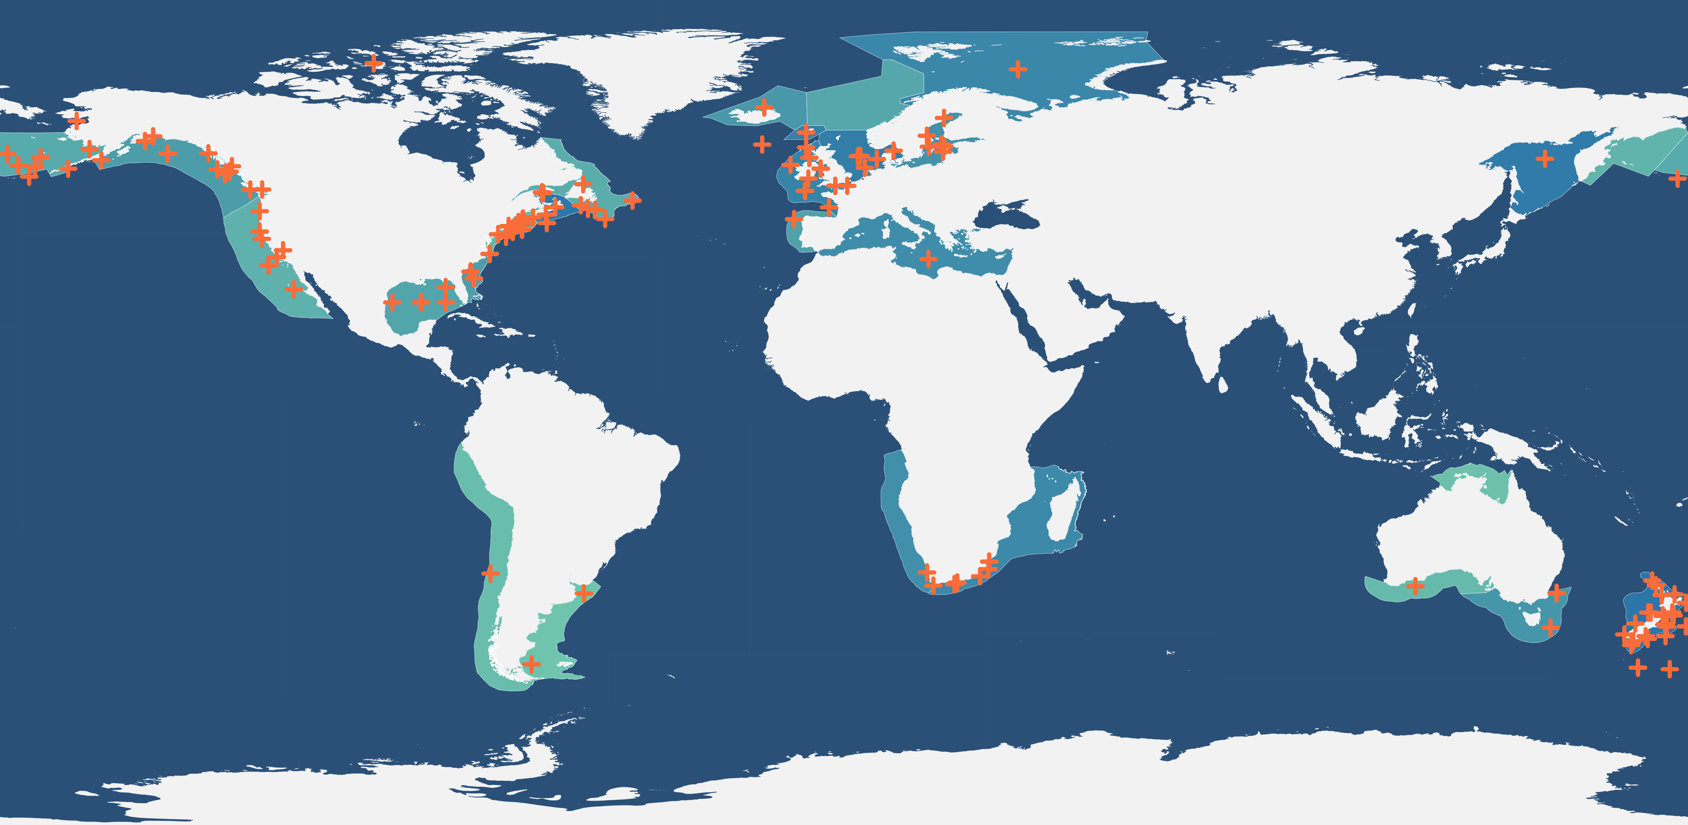

Slide 12
Hierarchical Bayesian (Cormack-Jolly-Seber) Survival Model
y_{i,t} = ‘survival’ (yes/no) of stock i at year t
ϕ_{i,t} = probability that stock i survives year t
x₁ = Human development Index (United Nations)
x₂ = Fish species richness (Fishbase)
x₃ = Δ sea surface temp
x₄ = plastic debris counts
x₅ = chlorophyll a
x_{6,i} = harvesting pressure (stock level)
t = year

Slide 13
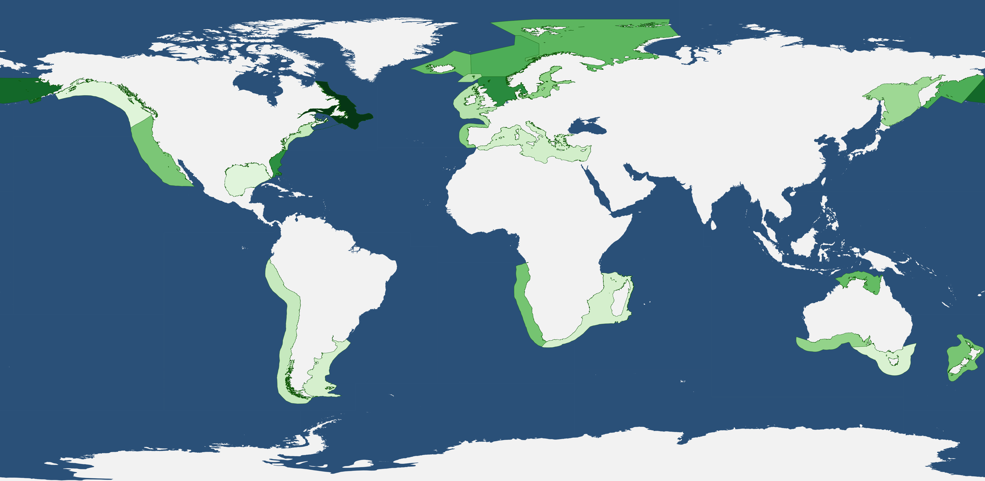

Slide 14
Species are different
Moran’s I: p = 0.85

Slide 15
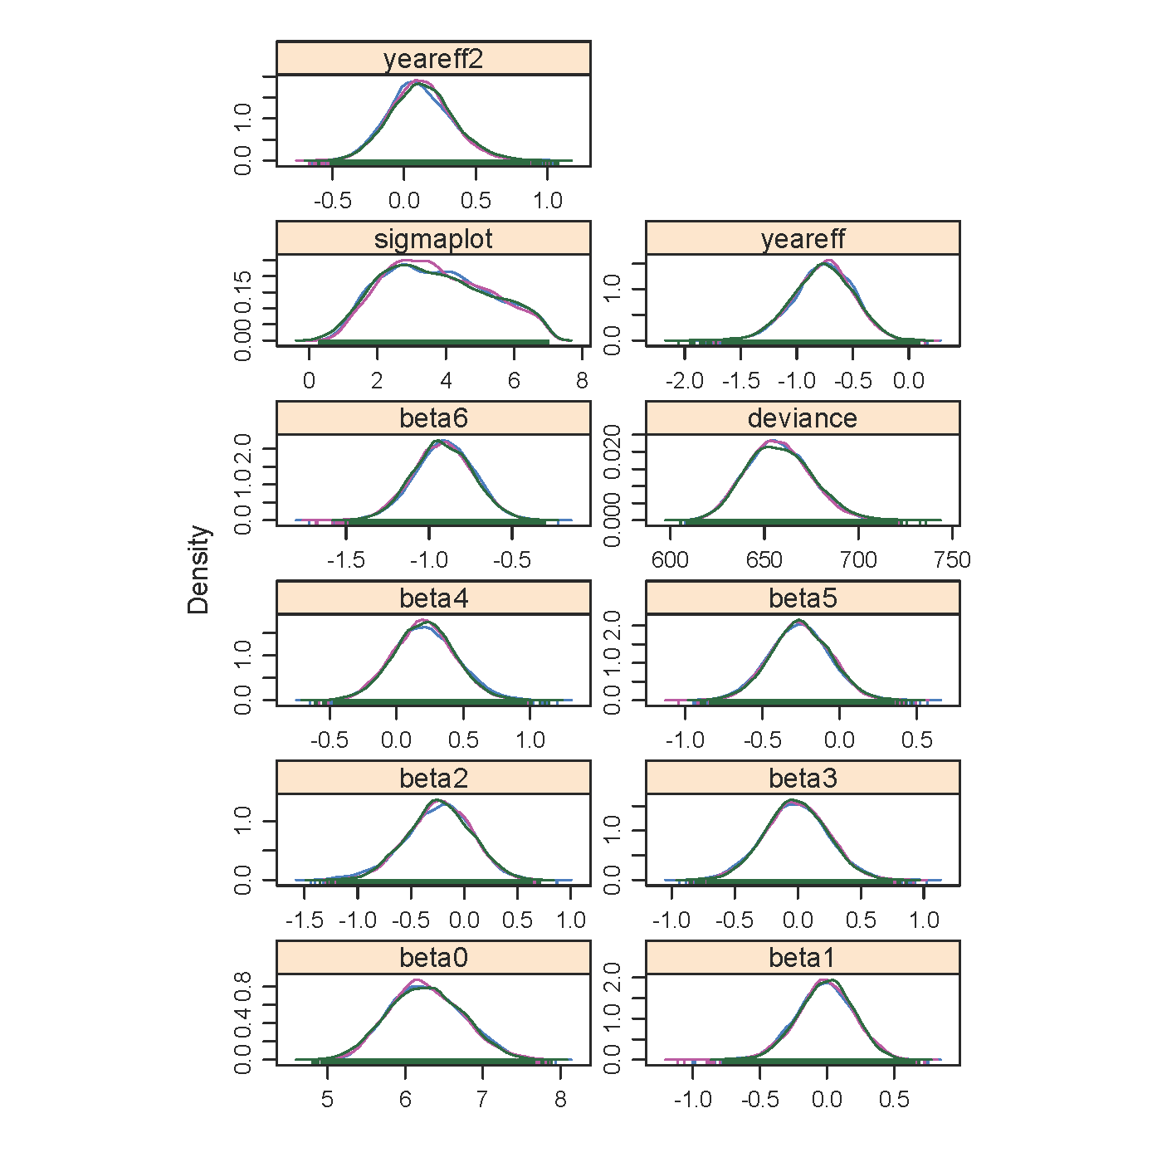
Posterior distribution of parameters
intercept
human development index
year
frequency
parameter value
Δ sea surface temperature
fish species richnes
year²
plastic counts
chlorophyll a
harvest intensity

Slide 16
Annual survival probability = φ
Probability of surviving t years = φ^{t}

Slide 18
Year

Slide 19
Take home messages:
bottom up effects can also be important
The per-unit-time survival probability has decreased 1945-2009
future plans to include a proxy for extreme events, perform model selection/averaging
Repeat this analysis to estimate the probability of recovery

Slide 20
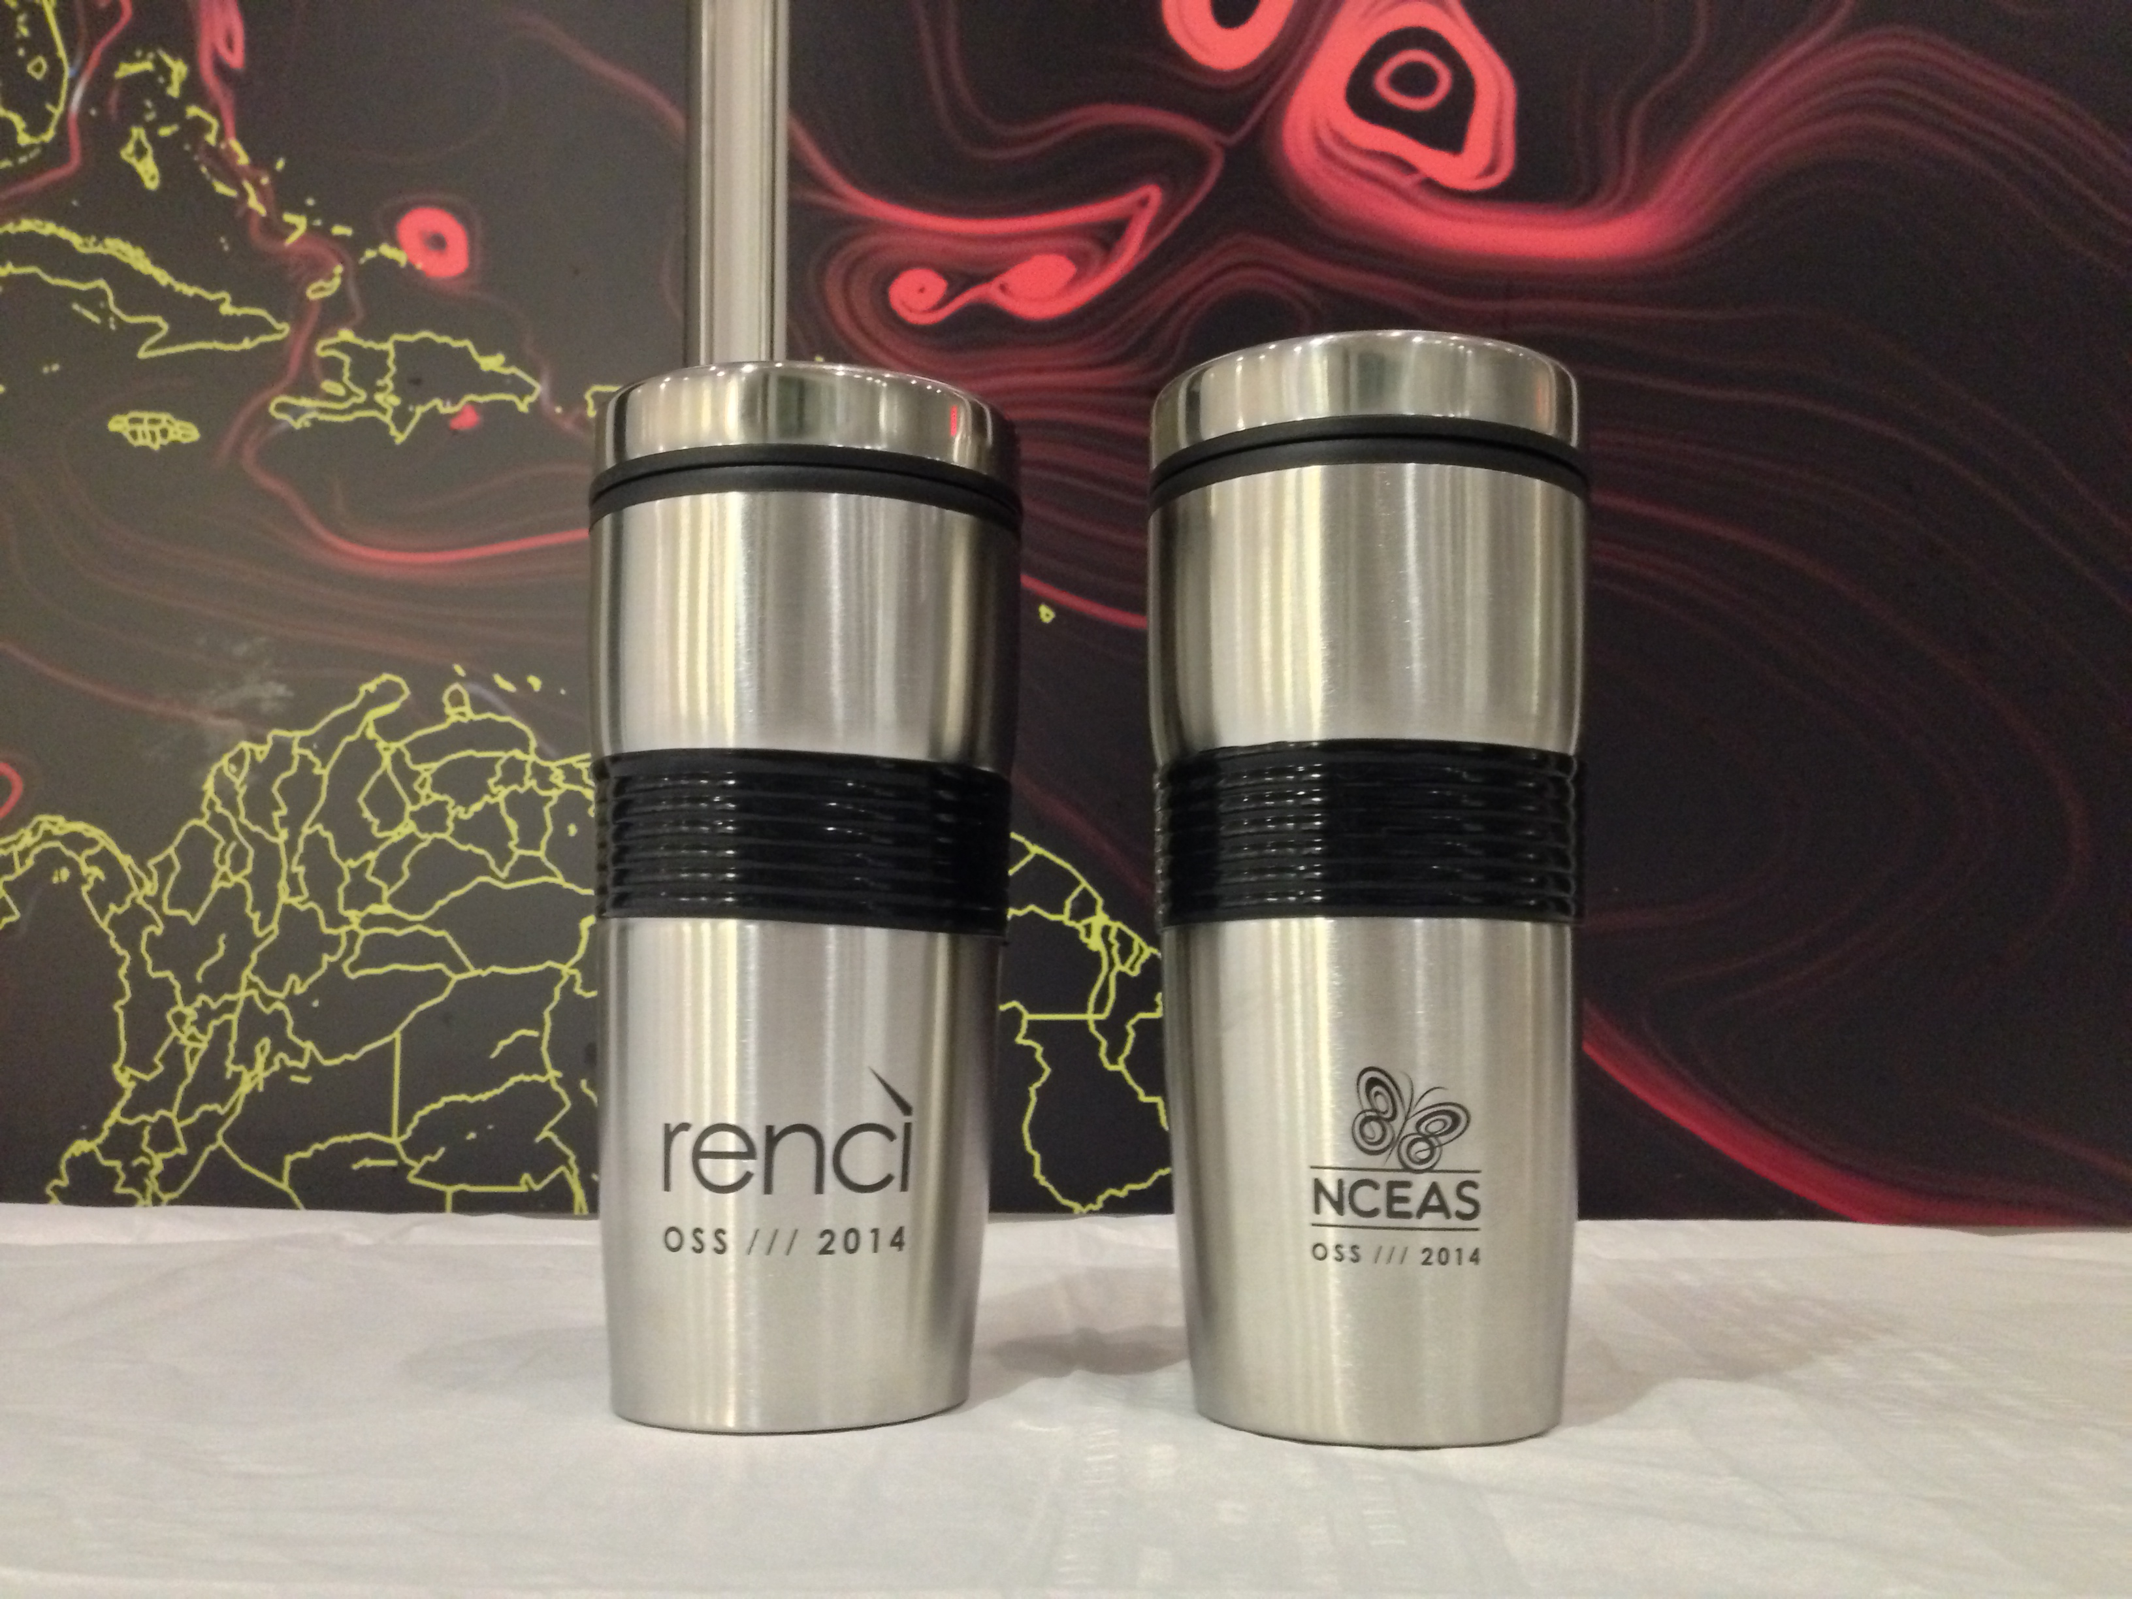
Thank you!
Ingrid Knapp - iknapp@hawaii.edu
Edgar J Gonzalez – edgarjgonzalez@ymail.com
Emma Fuller – efuller@princeton.edu
Annie Adelson – aadelson@stanford.edu
Benjamin Carr – bencarr@bu.edu
Nina Lany-Nina.K.Lany.GR@Datmouth.edu
Vanessa Michelou – michelou@Hawaii.edu

